Slide 1

COMP 305 Java Application Development
Khushbu Patel

Slide 2
Intro
About Myself
Background
Teaching
Hobbies
Icebreaker

Slide 3
COMP 305
Java Application Development
Course Outline
Learning Plan

Slide 4
JAVA
Popular programming language
Applications on web, desktop, mobile etc.
Language to communicate with the computer
How to build and run Java program?
JDK- Java development kit
Includes all required pieces
JRE, compiler, debuggers and tools to create java programs

Slide 5
JAVA
Virtual Machine
JRE- Java Runtime Environment
JDK – Java Development tool Kit

Slide 6
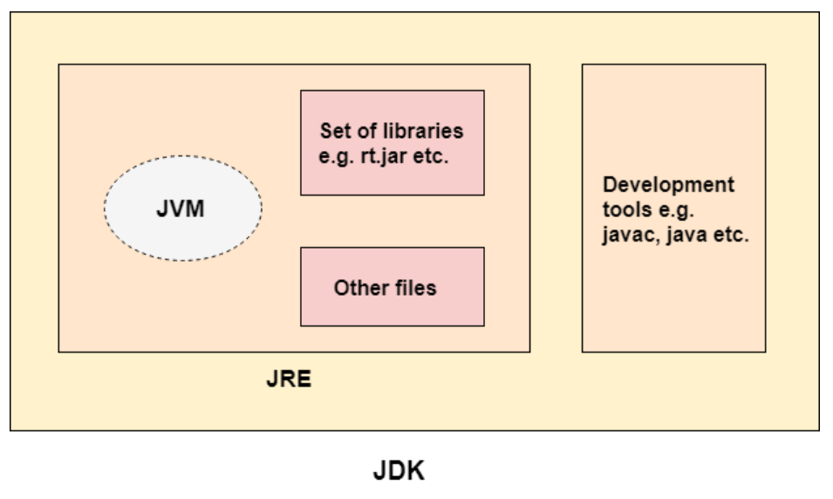

Slide 7
Java Features
Simple
Object Oriented
Portable
Platform independent
Secured
Robust

Slide 8
Java Features
Architecture independent
Interpreted
Performance
Multithreaded
Distributed
Dynamic

Slide 9
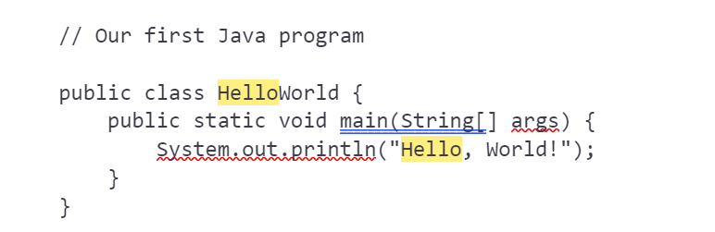
HelloWorld.java

Slide 10
Command Line
Commonly used tool
To build and run Java programs
User Interface for interacting with computer
E.g. Any action on the computer with the mouse. In place of mouse we are using the commands in command line to perform those actions
Commands - general
The command dir lists the contents of current folder
The command cd change directory
The command mkdir to make a new directory

Slide 11
Command Line
Commands – Java
The command javac HelloWord.java compiles the source code into bytecodes
The command java launches the JVM and executes the byte codes

Slide 12

In matters of style, swim with the current; in matters of principle, stand like a rock.
Thomas Jefferson

